Slide 1
The Wizard Control

Slide 2
The Wizard Control
Like Multiview control but with built-in yet customizable behavior, including navigation buttons, a sidebar with step links, styles, and templates.
Supports linear and nonlinear navigation
Can hide the sidebar by setting the Wizard.DisplaySideBar property to false.
supply the content for each step using any HTML or ASP.NET controls.

Slide 3
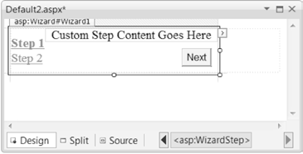
The region for step content

Slide 4
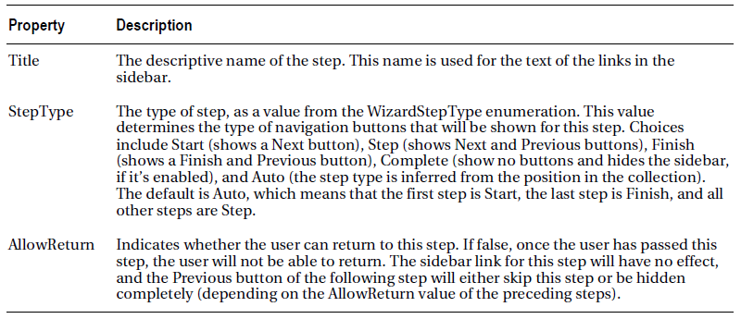
Wizard Steps

Slide 5
Example
<asp:Wizard ID="Wizard1" runat="server" Width="448px"
BackColor="#EFF3FB" BorderColor="#B5C7DE" BorderWidth="1px"
Font-Names="Verdana" CellPadding="5" ActiveStepIndex="0"
Font-Size="Small">
<WizardSteps>
<asp:WizardStep ID="WizardStep1" runat="server"
Title="Personal">
<h3>
Personal Profile</h3>
Preferred Programming Language:
<asp:DropDownList ID="lstLanguage" runat="server">
<asp:ListItem>VB</asp:ListItem>
<asp:ListItem>C#</asp:ListItem>
<asp:ListItem>Java</asp:ListItem>
<asp:ListItem>C++</asp:ListItem>
<asp:ListItem>C</asp:ListItem>
<asp:ListItem>Cobol</asp:ListItem>
</asp:DropDownList>
<br />
</asp:WizardStep>

Slide 6
Example
<asp:WizardStep ID="WizardStep2" runat="server"
Title="Company">
<h3>
Company Profile</h3>
Number of Employees:
<asp:TextBox ID="txtEmpCount" runat="server"></asp:TextBox><br />
Number of Locations: &nbsp;<asp:TextBox ID="txtLocCount"
runat="server"></asp:TextBox>
</asp:WizardStep>

Slide 7
Example
<asp:WizardStep ID="WizardStep3" runat="server"
Title="Software">
<h3>
Software Profile</h3>
Licenses Required:
<asp:CheckBoxList ID="lstTools" runat="server">
<asp:ListItem>Visual Studio 2010</asp:ListItem>
<asp:ListItem>Office 2010</asp:ListItem>
<asp:ListItem>Windows Server 2010</asp:ListItem>
<asp:ListItem>SQL Server 2010</asp:ListItem>
</asp:CheckBoxList>
</asp:WizardStep>

Slide 8
Example
<asp:WizardStep ID="Complete" runat="server" Title="Complete "
StepType="Complete">
<br />
<asp:Label ID="lblSummary" runat="server" Text="Label"></asp:Label>
<br />
<br />
Thank you for completing this survey.<br />
Your products will be delivered shortly.<br />
<br />
</asp:WizardStep>
</WizardSteps>
<SideBarStyle VerticalAlign="Top" />
</asp:Wizard>

Slide 9
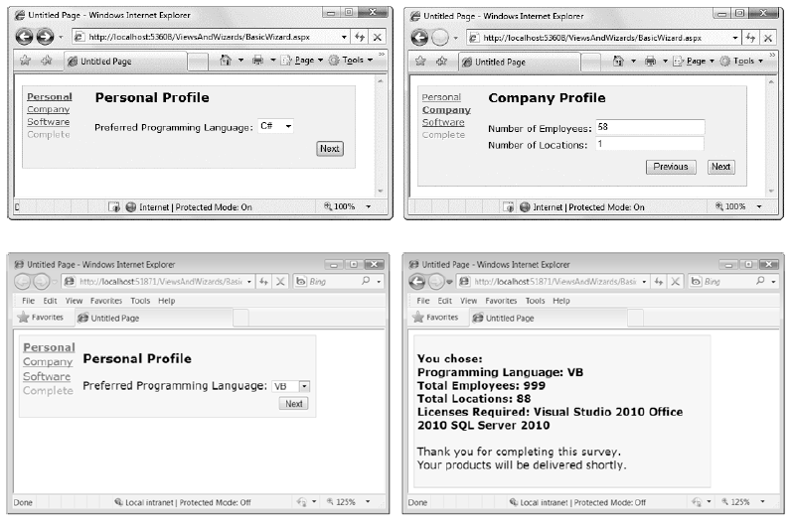
A wizard with four steps

Slide 10
A wizard with four steps
Select the step from the smart tag to choose which step you’re currently designing.
Be warned—every time you do, Visual Studio changes the Wizard.ActiveStepIndex property to the step you choose.

Slide 11
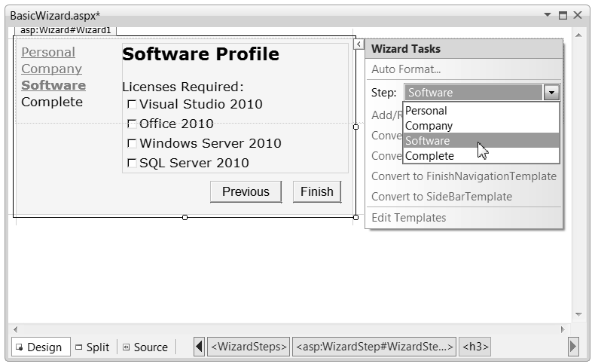
Designing a Step

Slide 12
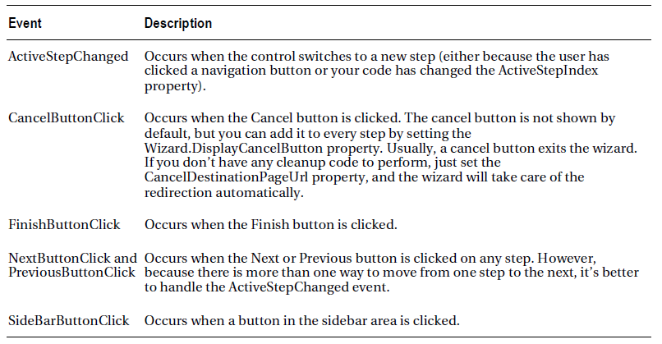
Wizard Events

Slide 13
Wizard programming models
Commit-as-you-go
each wizard step wraps an atomic operation that can’t be reversed
set the AllowReturn property to false on some or all steps
respond to the ActiveStepChanged event to commit changes for each step.
Commit-at-the-end
each wizard step is collecting information for an operation that’s performed only at the end
execute some code when the wizard is finished by reacting to the FinishButtonClick event

Slide 14
Example of code that response to
Protected Sub Wizard1_FinishButtonClick( ByVal sender As Object, ByVal e As System.Web.UI.WebControls.WizardNavigationEventArgs) Handles Wizard1.FinishButtonClick
Dim sb As New StringBuilder()
sb.Append("<b>You chose: <br />")
sb.Append("Programming Language: ")
sb.Append(lstLanguage.Text)
sb.Append("<br />Total Employees: ")
sb.Append(txtEmpCount.Text)
sb.Append("<br />Total Locations: ")
sb.Append(txtLocCount.Text)
sb.Append("<br />Licenses Required: ")
For Each item As ListItem In lstTools.Items
If item.Selected Then
sb.Append(item.Text)
sb.Append(" ")
End If
Next
sb.Append("</b>")
lblSummary.Text = sb.ToString()
End Sub

